Slide 1
THE INTERNET

Slide 2
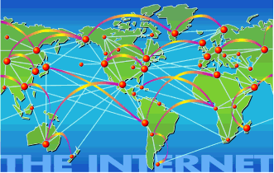
WHAT IS INTERNET?
The Internet is a global, interconnected computer network
Every computer connected to it, can exchange data with any other connected computer.

Slide 3
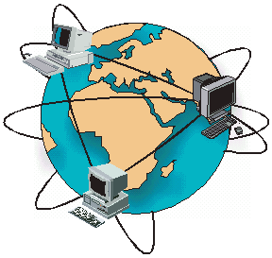
HOW DOES IT WORK?
Internet is composed of a multitude of networks around the world.
Each network is connected to a separate entity (university, provider of internet access, military).
To contact them, the networks share business data establishing a direct connection.
Each network is connected to several other networks.

Slide 4

WHAT IS A DOMAIN?
A domain name is an identification label that defines a realm of administrative autonomy, authority, or control in the Internet, based on the Domain Name System (DNS).
The Domain is an identification system that locates the organization owner of that domain, such as "wikipedia.org". On an email address, it is often written at the end.

Slide 5
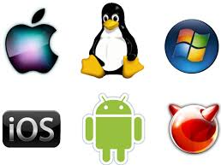
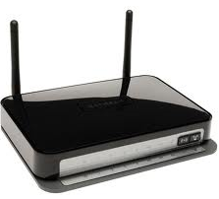
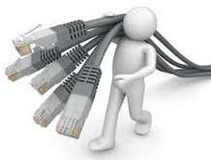
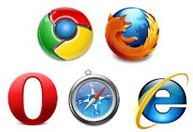
ACCESSING THE INTERNET
You will need:
  A computer with an operating system, such as Windows, MAC OS, or UNIX, that supports Internet protocols
  Communications equipment such as a modem, ISDN adapter, or Ethernet card
  An Internet service provider (ISP)
  Web browser software such as Internet Explorer or Google Chrome

Slide 6
ACCESSING THE INTERNET
The Internet can be accessed in the following ways:
  -Dial-up access with Point-to-Point Protocol (PPP)
  -Digital Subscriber Line (DSL)
  -Cable and satellite access
  -LAN access

Slide 7
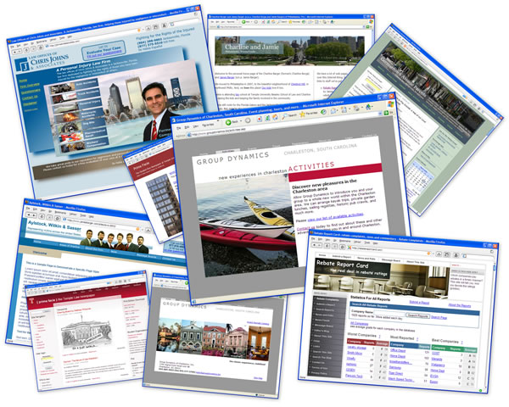
WEBSITE
A Web site is a collection of related Web documents that are made available to the public.
The index page, or home page, is the first page of a Web site.
Web pages are individual Web documents.
A web page contains: text, images, audio and attached documents.

Slide 8
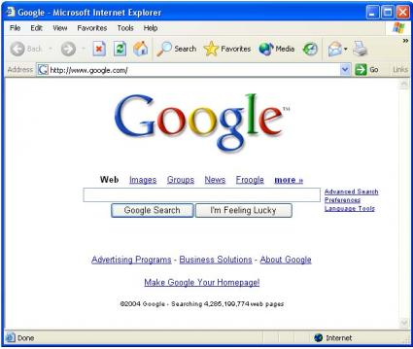
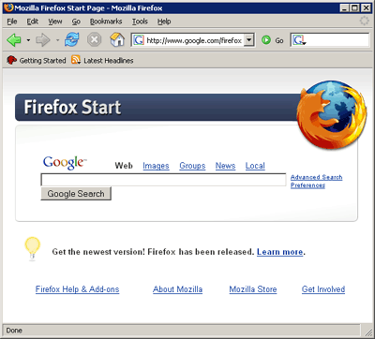
WHAT IS A WEB BROWSER?
The web browser is a software application whose main function is to allow the user to consult all available information on the web.
A user uses the web browser in 3 different ways:
When typing an address in the address bar, the browser makes the research.
When he has a site inscribed in the list of favorite sites, the browser makes the research.
When following an hyperlink, the browser makes the research.

Slide 9
WHAT IS AN URL?
Web addresses are an addressing system that identifies where a Web resource is located.
The uniform resource locator (URL) is the standard used to identify Web resources.
The URL consists of:
Protocol identifies the means of access.
Server contains the domain name of the Web server.
Path identifies the location of the document.
Resource specifies the filename of the resource.
URL
http://
www.yahoo.com/
help/
shop/
shop-01.html

Slide 10
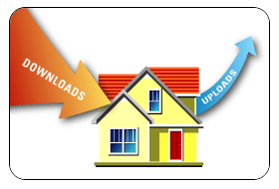
UPLOADING AND DOWNLOADING
Downloading – document or file is transferred from another computer to your computer
Uploading – files transferred from your computer to another computer

